Slide 1

NONCREDIT CURRICULUM TRAINING
Curriculum Committee Meeting
February 25, 2025
Dr. Omar Torres, President

Slide 2

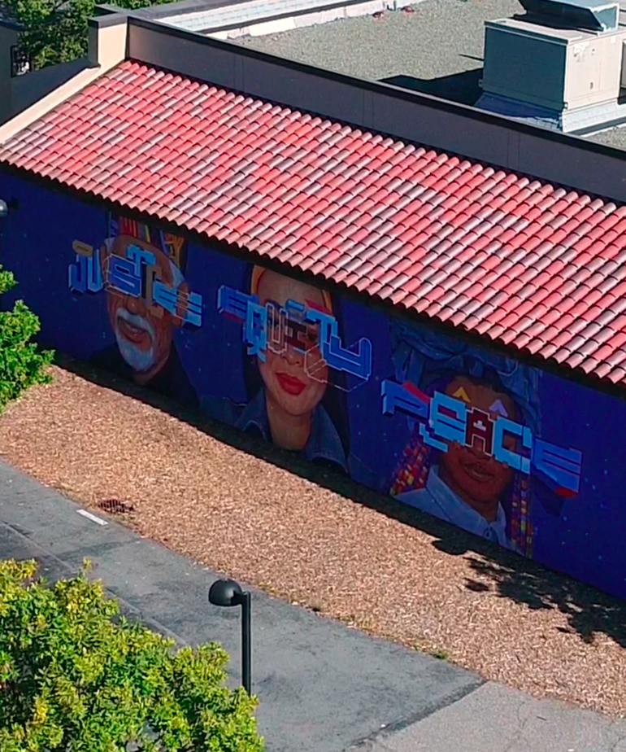
NONCREDIT CURRICULUM BASICS
1. English as A Second Language (ESL)*
2. Immigrant Courses
3. Elementary and Secondary Basic Skills*
4. Health and Safety
5. Substantial Disabilities
6. Parenting
7. Home Economics or Family and Consumer Sciences
8. Courses for Older Adults
9. Short-term Vocational Programs*
10. Workforce Preparation*
* = enhanced

Slide 3
CAREER DEVELOPMENT AND COLLEGE
PREPARATION (CDCP) PROGRAMS
Edu Code 84760.5 (b) -
Limits CDCP eligibility to courses in the following instructional domains:
Workforce Preparation
* Short-term Vocational
With High Employment Potential
Elementary and Secondary Basic Skills
English as a second language (ESL) and
vocational English as a second language
*CCCCO approval is required
Career Development
Certificate of Completion
Title 5,
§ 55151(h)
Certificate of Competency
Title 5,
§ 55151(i)
College Preparation

Slide 4
SIDE-BY-SIDE COMPARISON OF COR REQUIREMENTS
CREDIT
NONCREDIT
Unit value
Total contact hours for course
Conditions of enrollment: requisites, advisories, other conditions
Catalog description
Objectives
Content (typically in outline form)
Reading and Writing Assignments
Other outside-of-class assignments
Methods of instruction
Methods of evaluation/grading policy
Unit value
Total contact hours for course
Conditions of enrollment: requisites, advisories, other conditions
Catalog description
Objectives
Content (typically in outline form)
Reading and Writing Assignments
Other outside-of-class assignments/hours
Methods of instruction
Methods of evaluation/grading policy
*All noncredit courses mirrored with credit will need to conform to all credit requirements

Slide 5
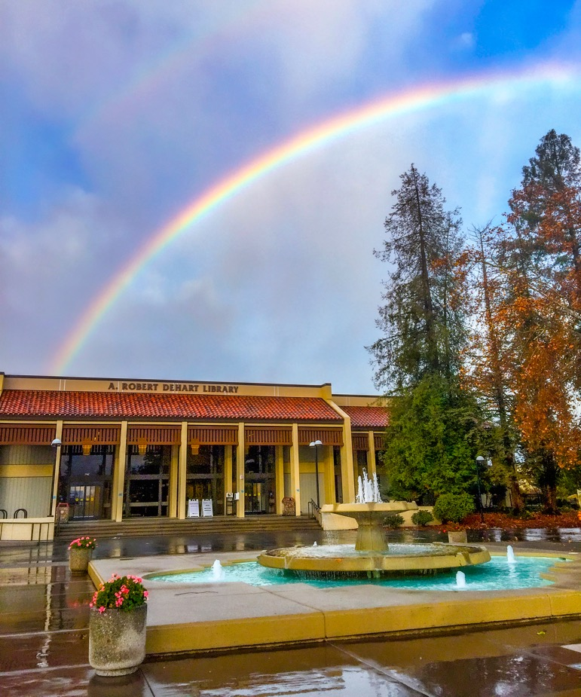
MINIMUM QUALIFICATIONS FOR NONCREDIT
Title 5 § 53412 lists the minimum qualifications (MQs) to teach noncredit. Although some MQs are the same as for credit instruction (i.e., §53410), some areas have different MQs including: Basic skills mathematics and English, English as a Second Language, health and safety, citizenship, home economics and older adults.
The Minimum Qualifications Handbook (also called the Disciplines List) details the requirements.

Slide 6

COLLABORATION BETWEEN CREDIT AND NONCREDIT
Noncredit Support Courses. These courses are designed together with credit faculty to support students who are currently enrolled or are preparing to enroll in credit courses.
Some options include
  Corequisite support courses
  Modularized support courses
  Intensive review courses
  Mirrored courses
  Business/industry-support courses
Partnerships between credit and noncredit faculty can be an effective way to help students meet their educational goals
Courses that build bridges between credit and noncredit can be a way to introduce noncredit offerings to faculty that typically teach credit courses

Slide 7
NONCREDIT AT DE ANZA (MOVING FORWARD)
The following are now approved moving forward:
Noncredit courses must be mirrored from a credit course
Noncredit courses must belong on a noncredit certificate
Noncredit courses must be in CTE or Basic Skills
For noncredit mirrored courses, noncredit courses have no load and no seat count; no restrictions if not mirrored.
For noncredit mirrored courses, noncredit courses must hold the same delivery modes as the credit course; no restrictions if not mirrored.
For noncredit mirrored courses, noncredit courses will be placed on the same review cycle as the credit course if the noncredit course is created with a different effective year; no restrictions if not mirrored.
For noncredit mirrored courses, requisites and advisories need to be specified in the COR of the credit and noncredit courses to reflect if the noncredit and credit are to be listed (ex. “Prerequisite: AUTO 50 or AUTO 350”); no restrictions if not mirrored.

Slide 8

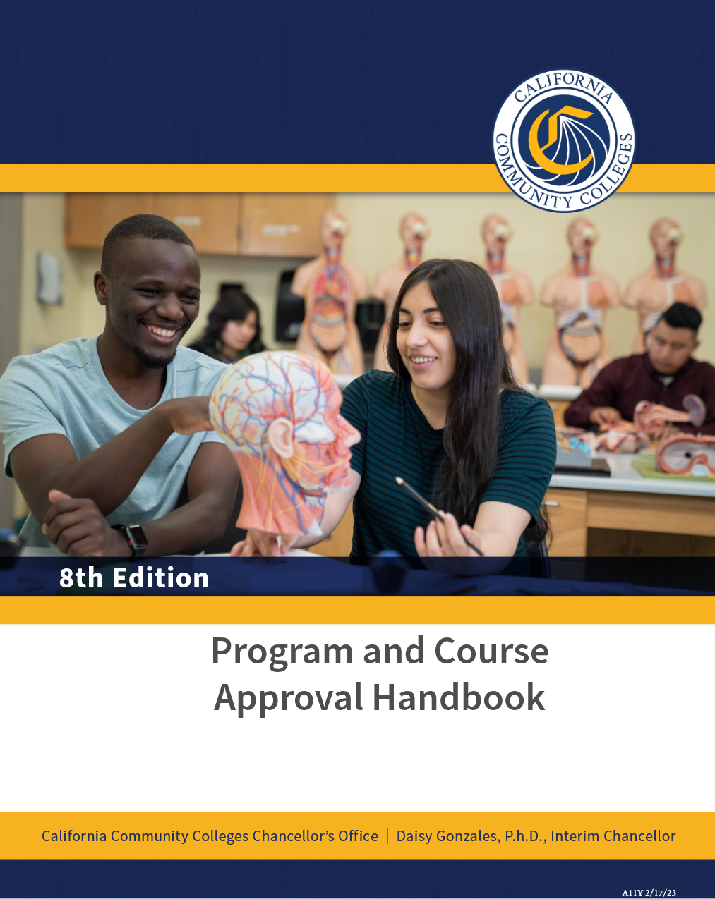
READ THE PCAH! SPECIFICALLY, PAGES 103-145

Slide 9
WHAT IS OUT THERE, AND YOUR IDEAS?
Mt. San Antonio College School of Continuing Education
San Diego College of Continuing Education
Santa Ana College School of Continuing Education
North Orange Continuing Education
College of the Canyons School of Personal & Professional Learning
See spreadsheet for existing 90 enhanced (blue) and 5 non-enhanced active NC courses at DAC
What ideas do you have for the development of new continuing education (noncredit) courses? Please email the CEO, VPI, and AVPI your new “top 10” ideas (course and NC category) by Friday, 2/21/25.

Slide 10
Other Noncredit Resources
Academic Senate CCC http://asccc.org
CCC Chancellor’s Office http://cccco.edu
Vision Resource Center https://visionresourcecenter.cccco.edu/
California Adult Education Program https://caladulted.org/
Association of Community and Continuing Education (ACCE) http://www.acceonline.org/
California Council of Adult Educators (CCAE) https://www.ccaestate.org/
DataVista https://datavista.cccco.edu/

Slide 11


