Slide 1
Skills for a future strong workforce

Slide 2
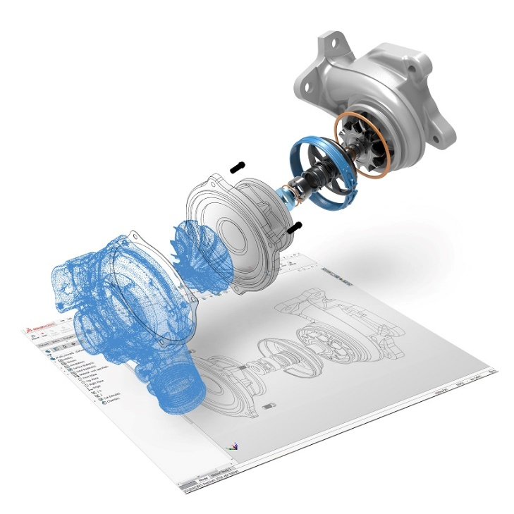
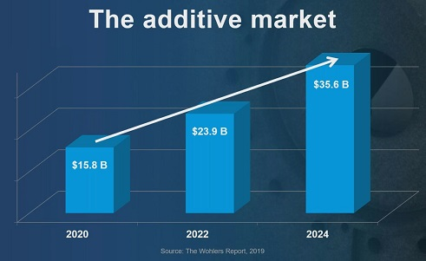
DMT - Skills for the future
Critical skills for Mechanical Engineers and Industrial Designers and many other jobs.
  CAD - Parametric Mechanical Design tools
  3D Printing / Additive Manufacturing “AM”
  Traditional Manufacturing, CNC & CAM

Slide 3
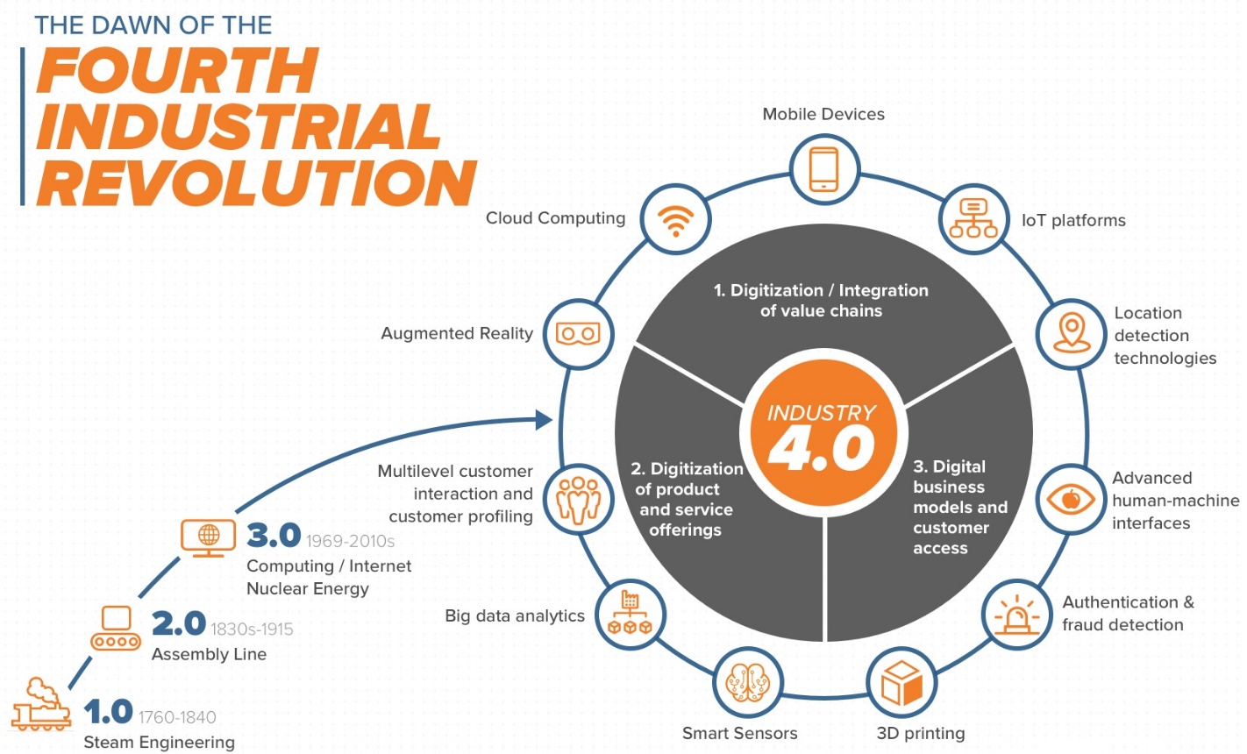
Charting your own pathway to professional success in the 4th Industrial Revolution

Slide 4
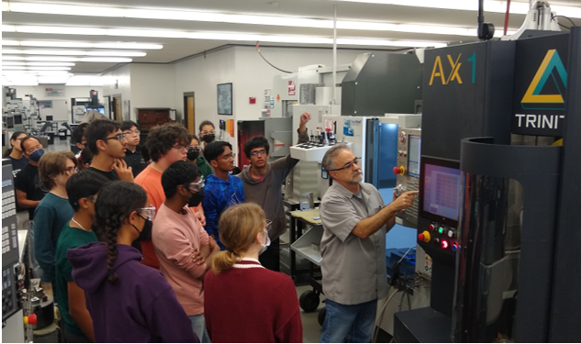
Engineering pathways in the Design & Manufacturing Technologies Department at De Anza College
DMT 55
Course Description – Fall 2024
This survey course is designed to introduce students to both design, manufacturing and modern fabrication, by means of demonstrations, with the following areas of emphasis: 3D Engineering CAD systems, (3D Printing), manufacturing processes, equipment and systems, design for manufacturing, measurement tools, blueprint reading, rapid prototyping CNC machine set-up, CNC machine programming (lathe and mill) and CAM. This hands on, team based course is designed to provide students with instruction & skills through applied real world experience to enable insight as to how products are designed and fabricated.

Slide 5
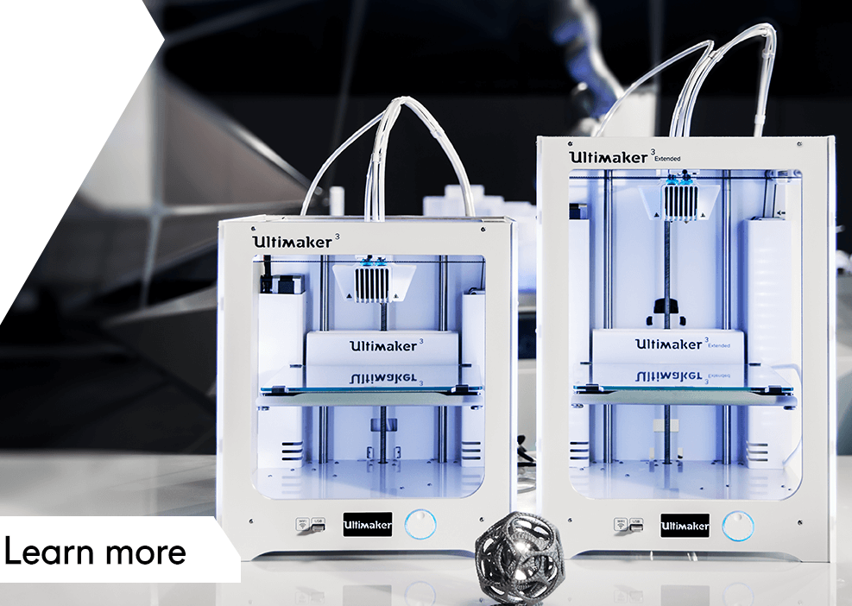
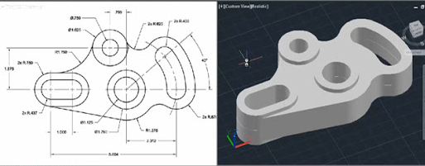
Engineering pathways in the Design & Manufacturing Technologies Department at De Anza College
DMT 55
4 weeks of rudimentary parametric solid modeling “CAD”, projects and best practices of engineering software.
4 weeks of hands on Mill, Lathe, how to read a drawing and basic measurement tools usage
4 weeks of 3D Printing, current industry technology, fixing & editing STL files, slicing software and basic Design for Additive Manufacturing “DfAM”

Slide 6
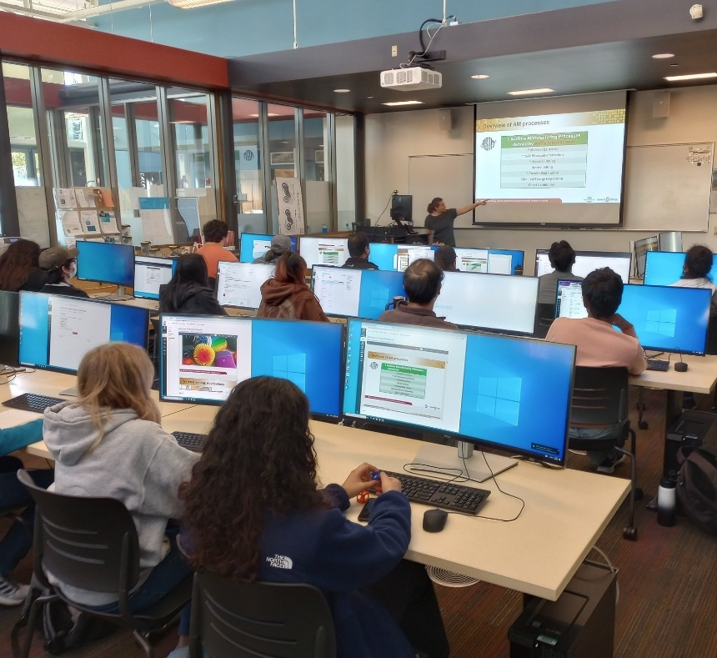
Engineering pathways in the Design & Manufacturing Technologies Department at De Anza College
DMT 53
Course Description – Winter 2024
The objective of this course is to present a comprehensive overview of 3D Printing, spanning from fundamentals to applications and technology trends. Participants will learn the fundamentals of (AM) Additive Manufacturing/3D Printing of polymers, metals, composites, and biomaterials, and will realize how process capabilities (rate, cost, quality) are determined by the material characteristics, process parameters, and machine designs.

Slide 7
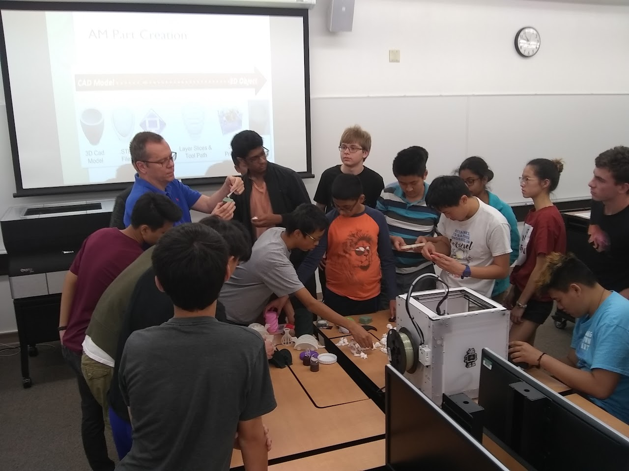
Engineering pathways in the Design & Manufacturing Technologies Department at De Anza College
DMT 53
Course Review – Winter 2024
Recent high school student comment
“I also just wanted to thank you for being a great professor during the quarter. You and Max both did a wonderful job at instructing a fun and efficient course to get people familiar with additive manufacturing and I am very grateful to have been a part of it. I have learned a lot through DMT 53 (and also DMT 55), and will definitely retain this knowledge not only through the parts we've printed and created but also through the entire industry to which I have been newly exposed to.
Thank you for being you, it was an awesome quarter.”

Slide 8
Class offerings in the Design and Manufacturing Technologies Department at De Anza College
CAD
  Creo Parametric
    DMT 65,66,67,68
  Pro/Engineer
  SolidWoks
    DMT 60,61,62,63
  Siemens NX
  Autodesk Inventor
  GD&T
3D Printing “AM”
  Intro to 3D Printing
    DMT 53
  Beginning Design
    DMT 54
  AM Technician
  DfAM
    Design for Additive Mfg
www.deanza.edu/dmt/

Slide 9
DMT Dept’ offers professional Engineering pathway skills
CAD
CAD designers use specialized computer software to generate drawings, blueprints, plans, and other design documents for use across a wide variety of fields (mechanical design, architecture, construction, engineering, etc.
Design Your Future in CAD
3D Printing “AM”
Additive Manufacturing is rewriting the rules for how we design, build, and create in every major industry. From consumer product and industrial design, automotive, medical to Aerospace industries, the landscape is changing fast and we are here to train the future workforce.
www.deanza.edu/dmt/

Slide 10


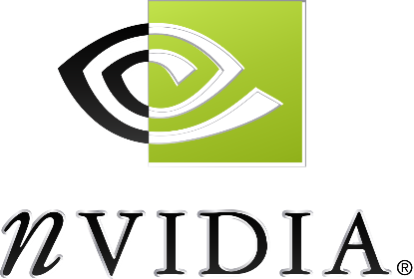






Local companies that use CAD to design products
CAD at De Anza College
Creo Parametric
Autodesk Inventor
SolidWorks
Siemens NX

Slide 11
Current Internships, Industry & career connections
Internships & Partners
  Sandia National Laboratories
  Lam Research
  NextFlex
  SME Silicon Valley Chapter 98
    Society of Manufacturing Engineers
    Local Industry tours and networking
    Resume & Career guidance
LinkedIn groups
  CAD
  CNC/CAM/MFG
  3D Printing/AM
DMT Partners
  HAAS
  Siemens
  Autodesk
  SME
www.deanza.edu/dmt/

Slide 12
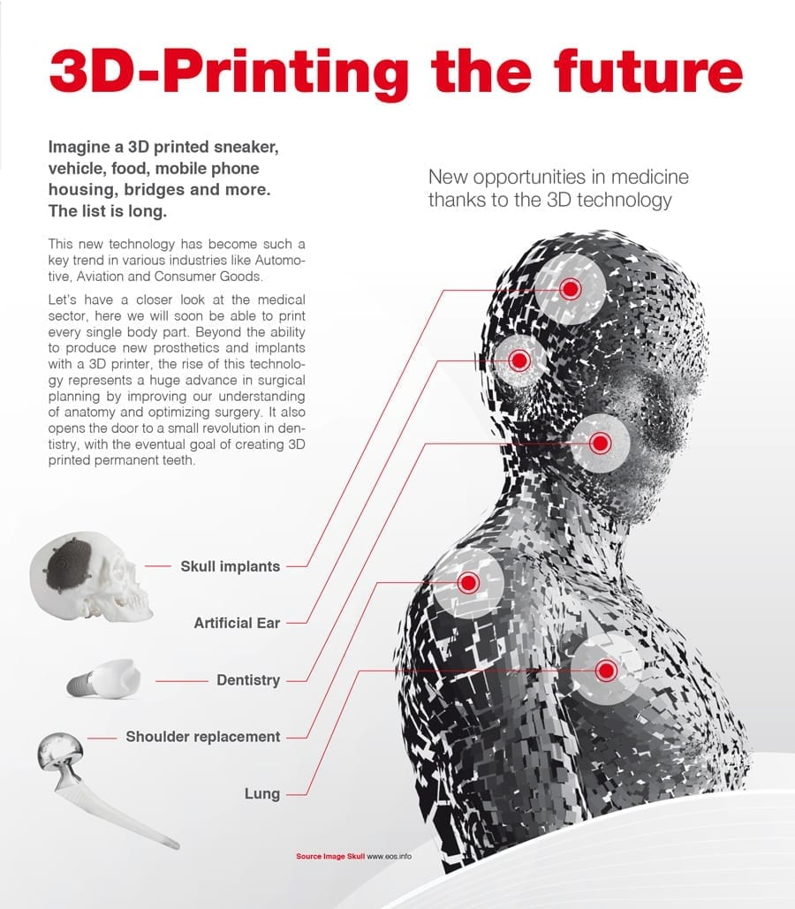
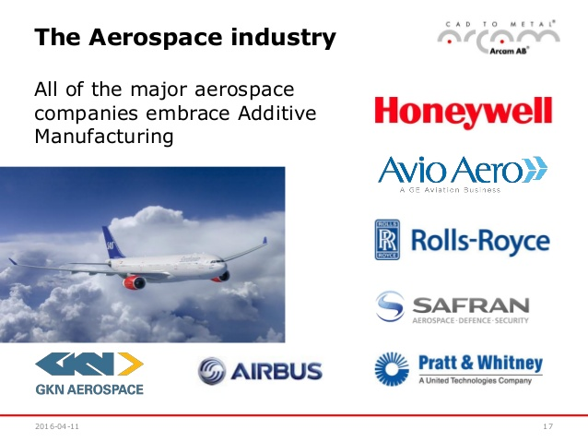
Nearly every industries use CAD & Most use 3D Printing
https://youtu.be/xRo2fx0PJog https://youtu.be/A2d96-bCpvo
https://jobs.gecareers.com/global/en/ge-additive-careers https://www8.hp.com/us/en/printers/3d-printers.html

Slide 13
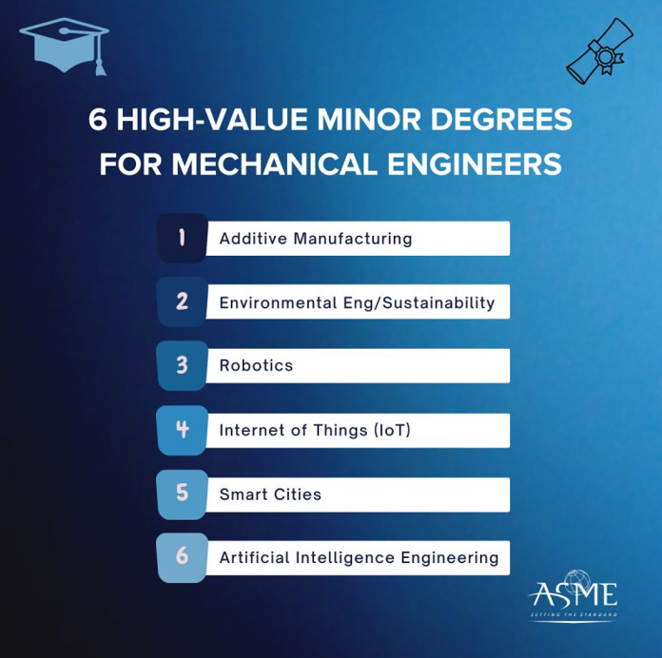
Nearly every industries uses CAD & Many use 3D Printing
https://youtu.be/xRo2fx0PJog https://youtu.be/A2d96-bCpvo
https://jobs.gecareers.com/global/en/ge-additive-careers https://www8.hp.com/us/en/printers/3d-printers.html

Slide 14

Why and When to use AM: Where does it fit in?
Subtractive
(e.g. Machining)
Formative
(e.g. Injection Molding)
Additive
(e.g. 3D Printing)
Part 2
Injection
Part 1
Support
Cast
Support
Support
Printed Material
  Complexity limited by tooling and assembly steps
  High initial investment for tooling
  Material waste
  Strong, precise parts
  Molding design & fabrication required = Even higher initial investment
  Cast removal (post-processing)
  Injection uniformity concerns
  Near shape parts
  Quasi-single step process
  Minimum material waste
  Near to final shape parts
  Post-processing
Additive Manufacturing alone is NOT the solution. The key is to find how to use its strength, combined with other manufacturing techniques to get best/better parts
Notes:
Additive Manufacturing or Direct Digital Manufacturing

Slide 15
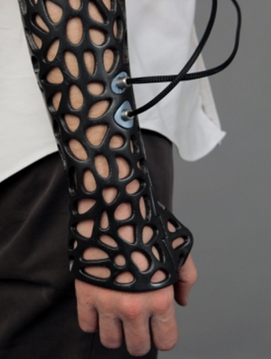

De Anza College training technology for your success
Equipment Investment
HP Multi Jet Fusion 3D Printer
Stratasys F370 & Fortus 250
Creaform 3D Laser Scanner
3D Systems Figure 4 - DLP
Stratasys Objet30 Pro - PolyJet
Markforged Carbon fiber 3D Printer
You can make almost any form with 3D Printing
- Volume or mass is expensive but complexity is free

Slide 16
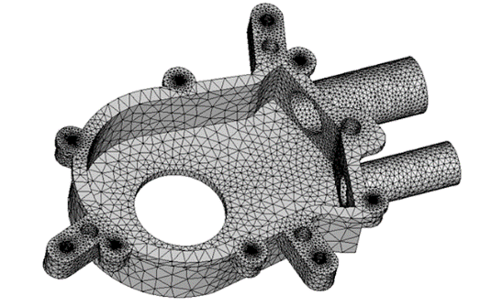
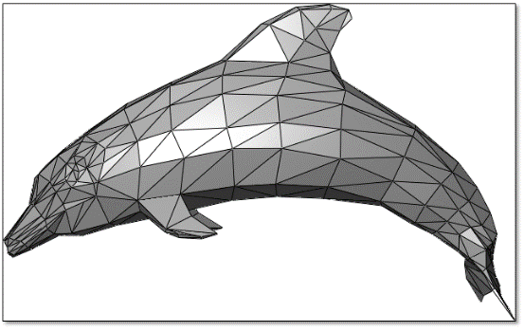
Universal aspects of all 3D printing
Prats are built Layer by Layer
  3D Geometry is converted to 2D slices, then recompiled during printing
CAD to Print File
  Software translates between your CAD geometry & 3D Printing process (slicing software)
  STL "stereolithography“ file

Slide 17
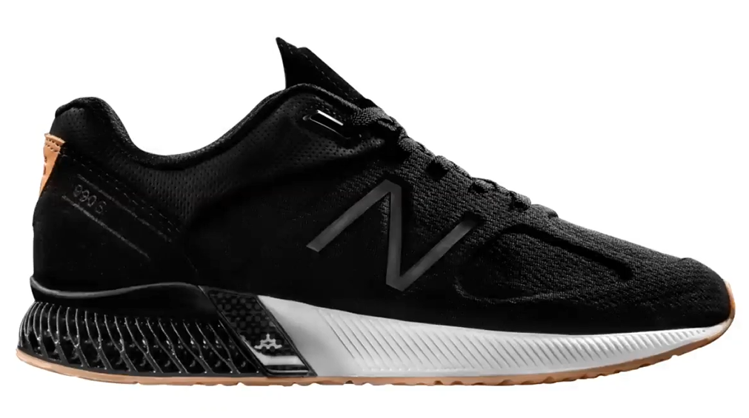
Basics of 3D Printing Technology
CAD to Print File, Typically STL or 3MF
Printing Process Mechanism (Pros & Cons)
  FDM/FFF
  SLS, MJF & DLMS
  SLA & DLP
  MJP - Material Jetting
Post Processing
Maintenance and Scalability

Slide 18
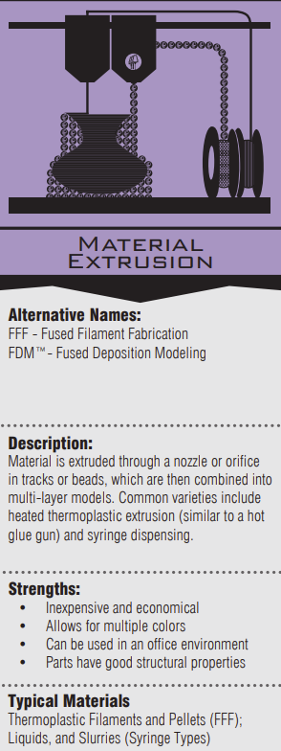
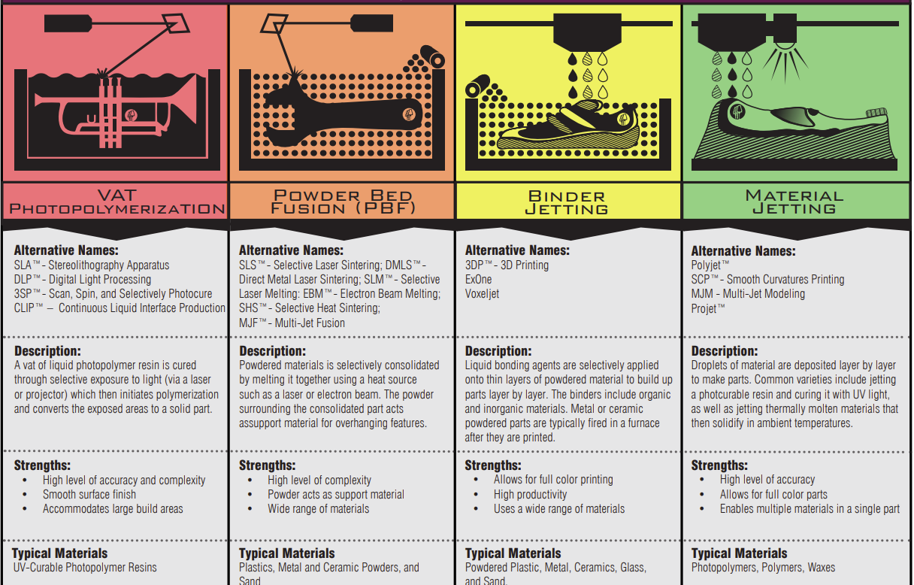

Slide 19
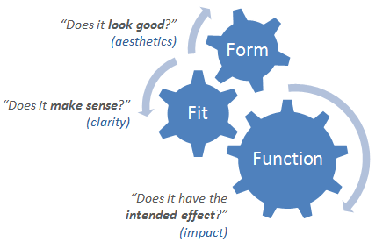
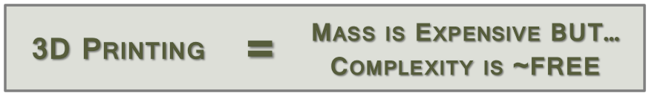
AM Technology Selection
FORM
  Weight, size, visual appearance / aesthetic choices
  Can printing technology reach required resolution?
  Does the printing technology offer color?
FIT
  Does the part connect, join, or fit?
  Can the printing technology meet tolerances?
  Can part fit into the available printer(s)?
FUNCTION
  Does the part perform its stated purpose
  effectively and reliably?
  Can printed material support the function
  (strength, weight, texture, etc.)?

Slide 20
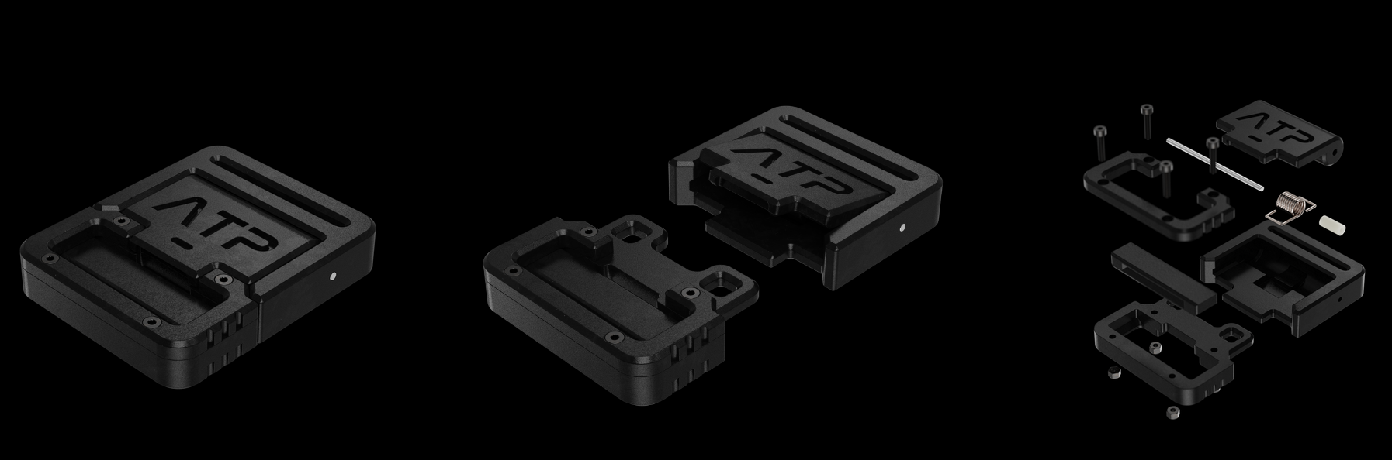
Resent Success story – A vision & passion for success
Dane Jones: https://www.daneerikjones.com/
Chemical Engineering student turned Designer, now works in AM Hardware industry

Slide 21
Overview of 3D Printing/Additive Manufacturing processes
VAT Photopoly-merization
Material Extrusion
Powder Bed Fusion
Binder Jetting
Material Jetting
Sheet Lamination
Directed Energy Deposition
ASTM Category
PROCESS
MATERIALS
TERMS & BRANDED PROCESS
3D object grown layer by layer from a VAT of liquid UV curable resins
3D object grown line by line, layer by layer from molten filaments
3D object grown from layers of selectively molten powder using energy beam
3D object grown from layers of bonded powder using selective adhesive jetting
3D object grown layer by layer by selectively jetting UV curable resins
3D object grown by bonding selectively cut laminate sheets
3D object grown by melting material as it is being deposited
Photopolymers
UV curable
Metal/Ceramic + polymers paste
ABS/PLA/PA12/PC
Fiber-infused, Metal-infused filaments
POWDERS
Nylons, PEEK, TPU
Metals
POWDERS
Sand
Metal
Ceramics
Plaster/Plastics
UV cured resins (rubber-like, rigid, biocompatible, high temp)
Paper + adhesive
Metal + adhesive
POWDER & WIRE
Metals
MJF
LMD/
DMD
SLA
FDM/
FFF
SLS
CJP
MJP
LOM
LENS
DLP
DMLS/
SLM
BJT
PJT
UAM
EBAM
CLIP
EBM
SPJ
NPJ
SDL
LDT

Slide 22
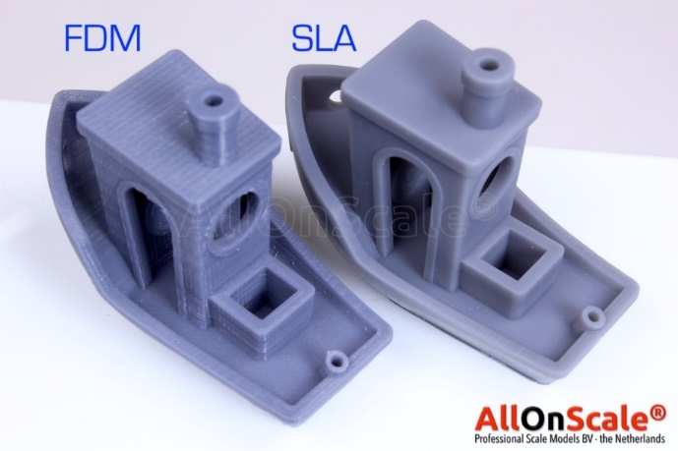
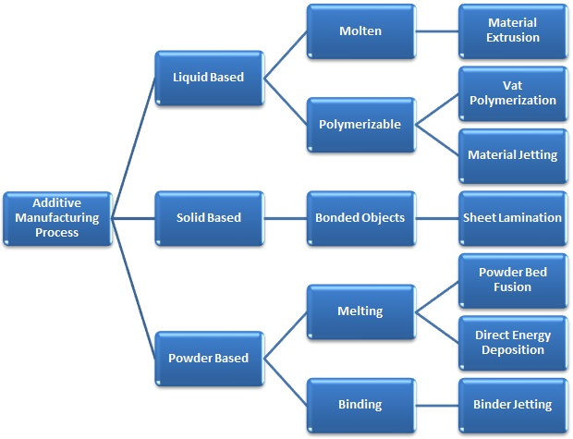
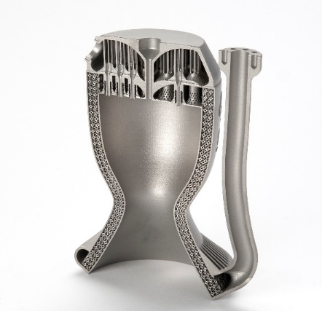
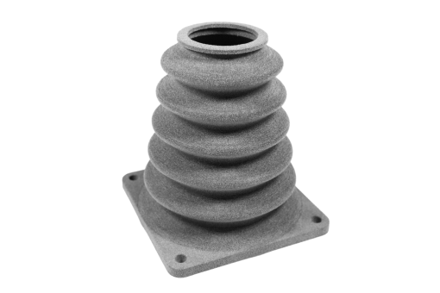
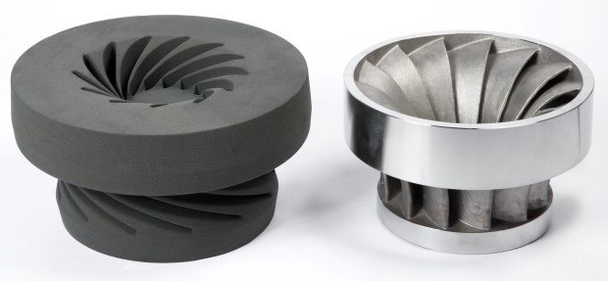
AM Technologies
(or sintering)

Slide 23
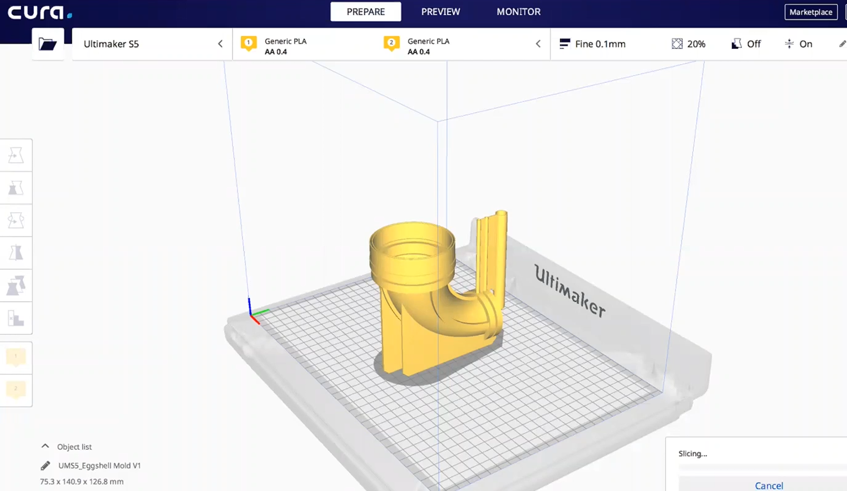
Slicing software

Slide 24
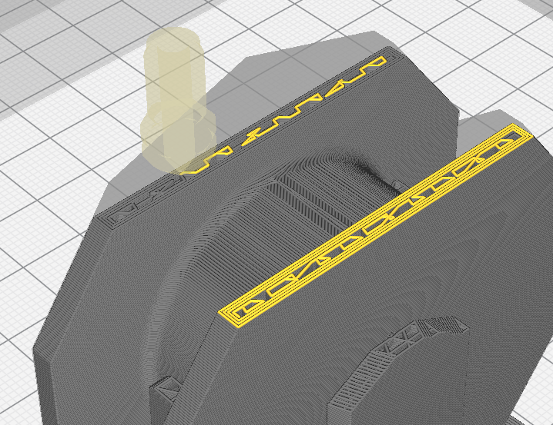
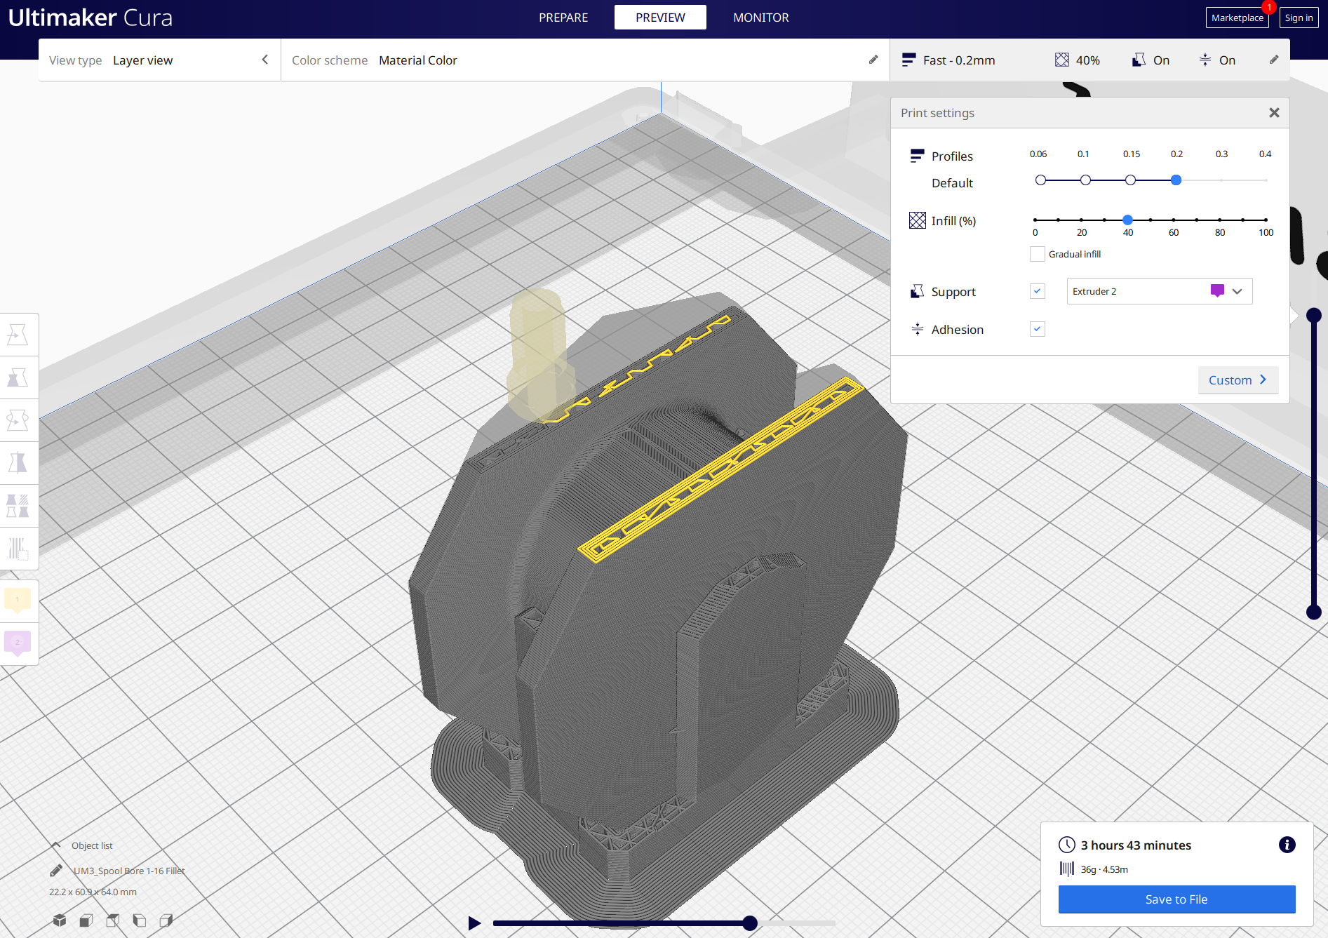
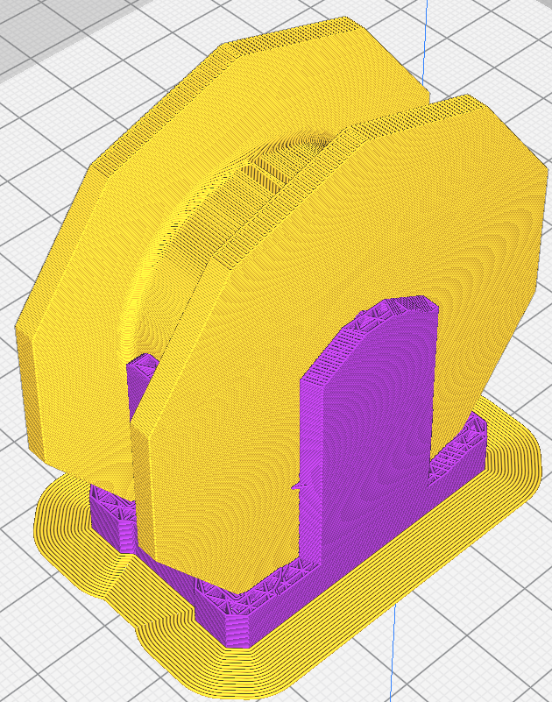
FDM slicing with support structure

Slide 25
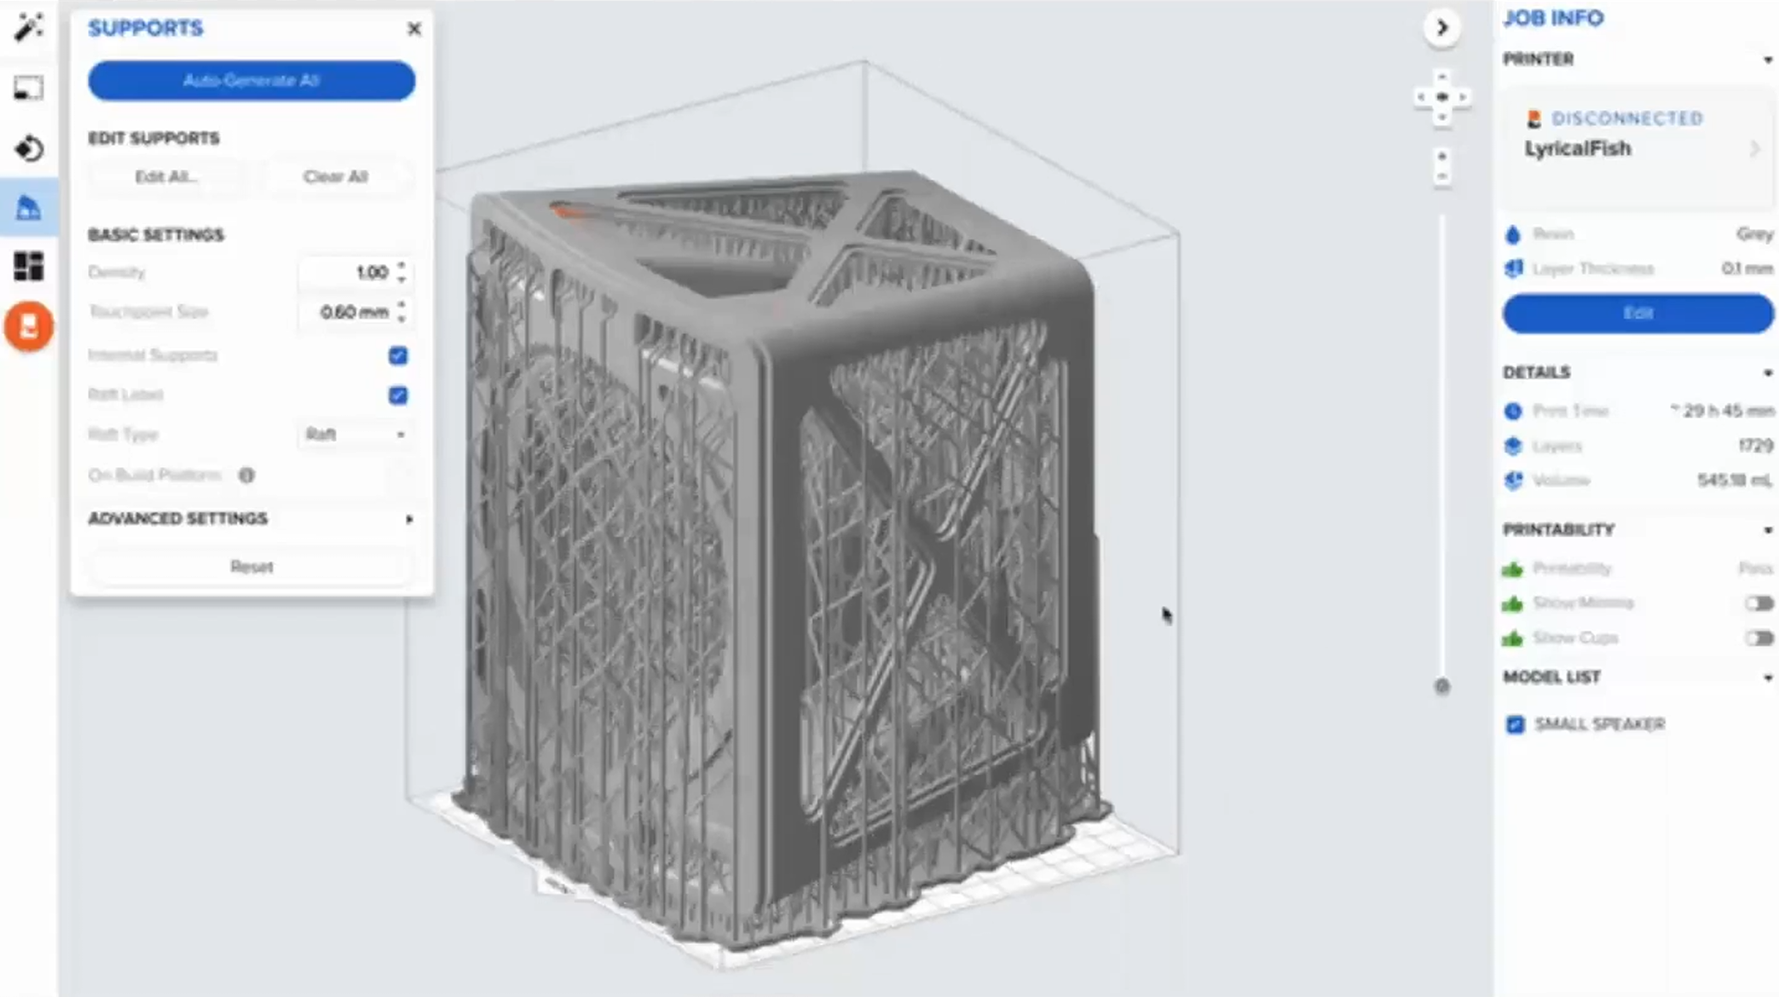
SLA & DLP slicing with support structure

Slide 26
Considerations when picking print technology
Print Process Mechanism
  How it Works
  Advantages
  Design considerations
FDM / FFF
  Fused Deposition Modeling / Fused Filament Fabrication

Slide 27
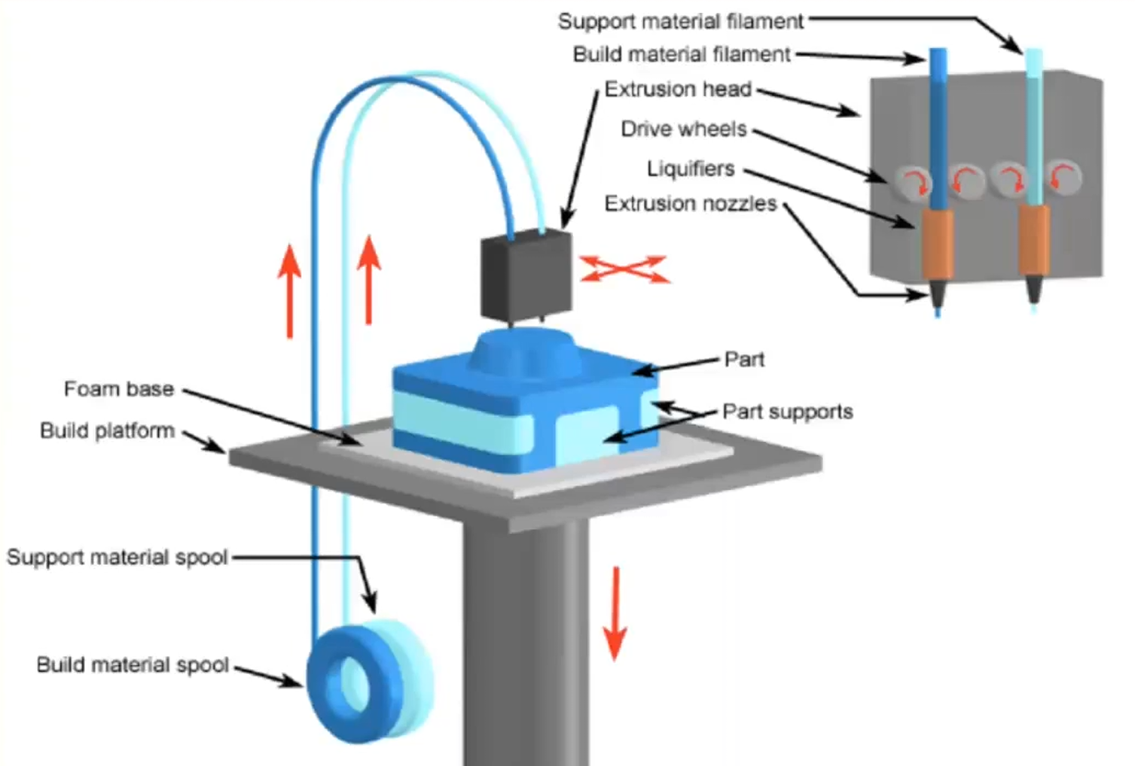
Fused Deposition Modeling / Fused Filament Fabrication
FDM / FFF

Slide 28
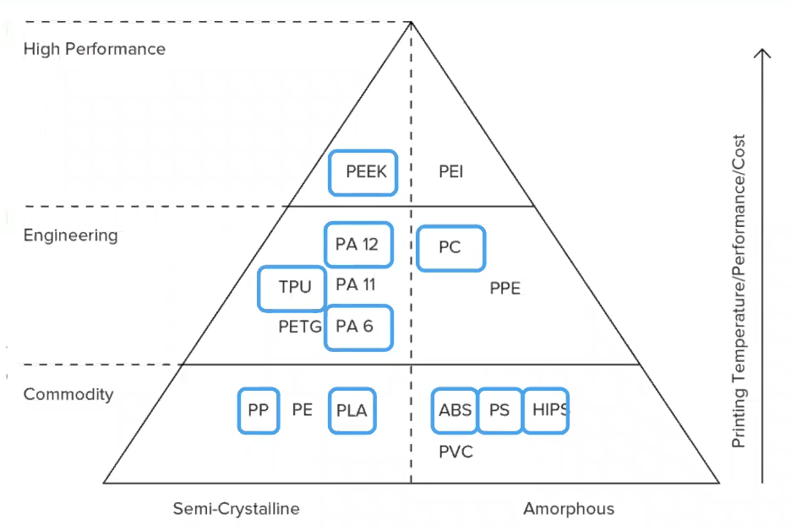
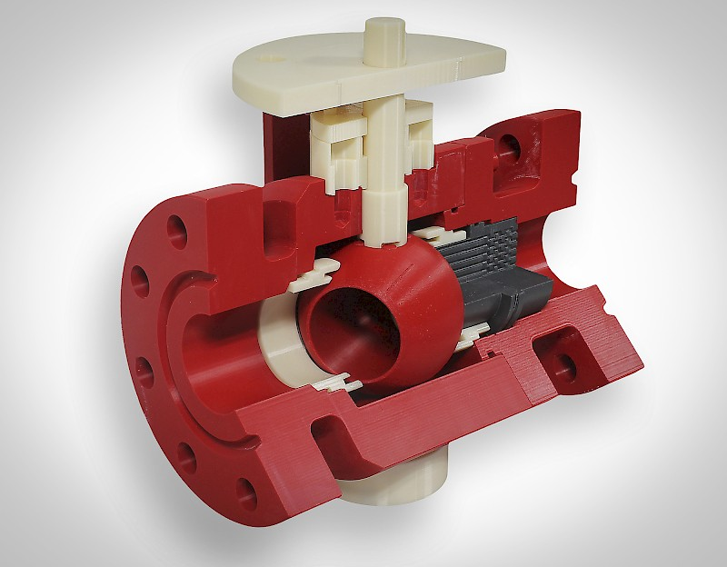
There are a wide range of thermoplastics for FDM
PLA, PETG, ABS, PC, PEEK, etc.
FDM typically capable of produces strong part – Engineering grade thermoplastics

Slide 29
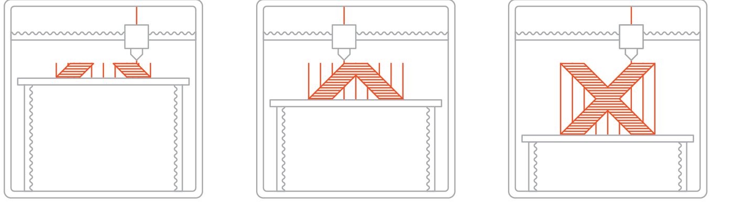
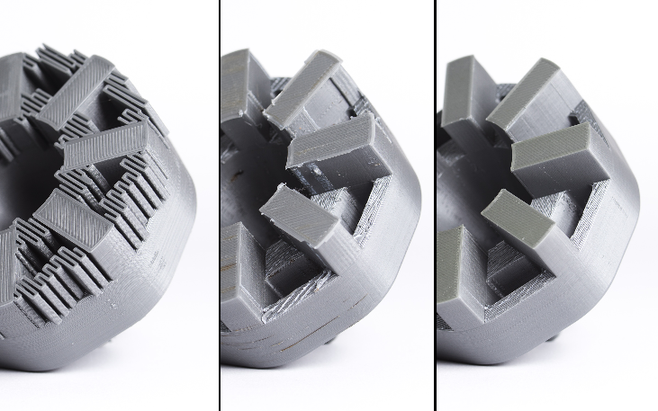
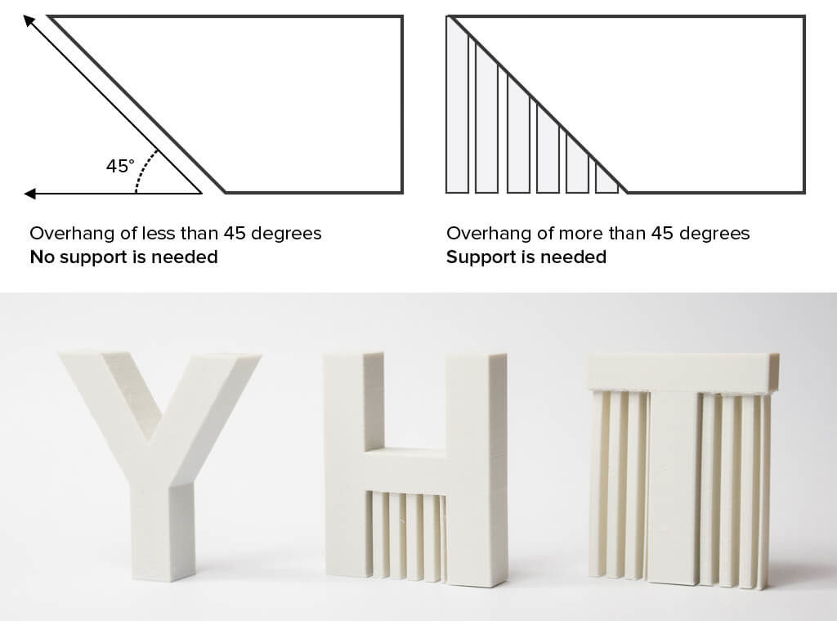
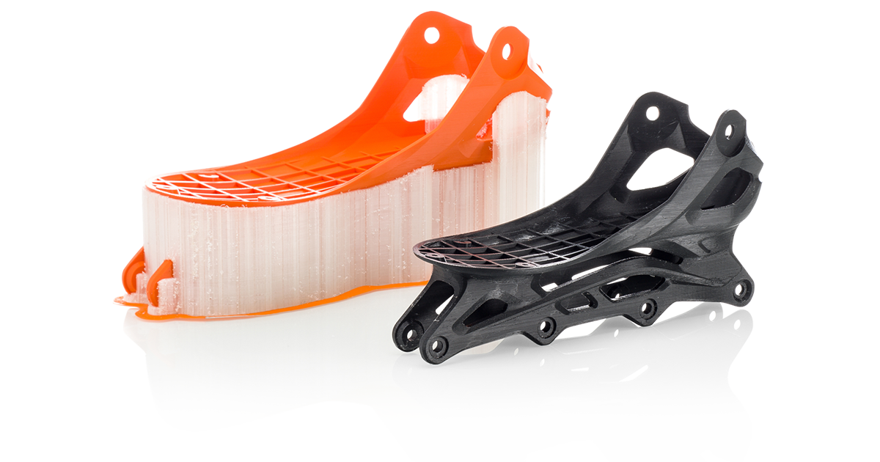
FDM Print Often Requires Support Structures

Slide 30
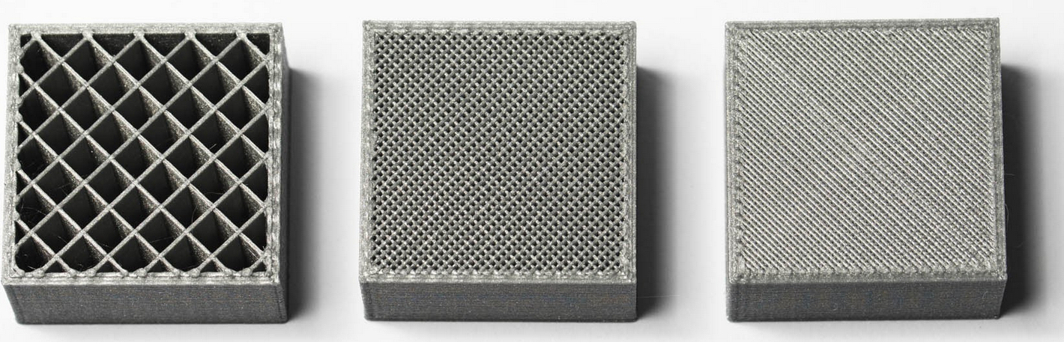
FDM is not solid like other processes
“Infill & Shell Thickness”
FDM parts are usually not printed solid to reduce the print time and save material.
Instead, the outer perimeter is traced using several passes, called the shell, and
the interior is filled with an internal, low-density structure, called the infill.

Slide 31
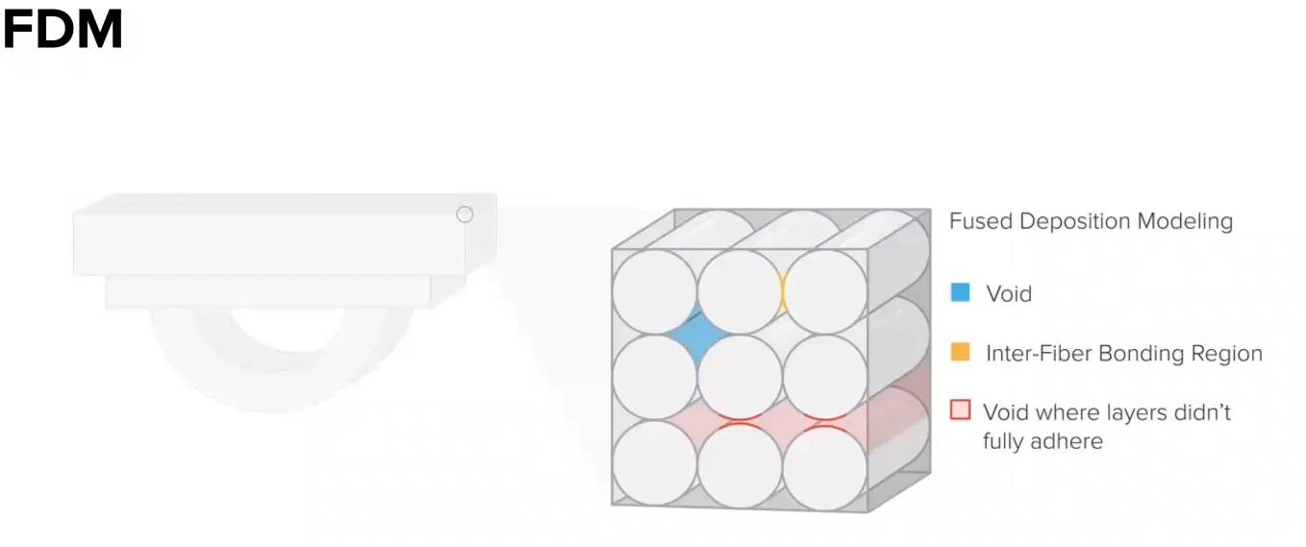
FDM/FFF: parts are anisotropic

Slide 32
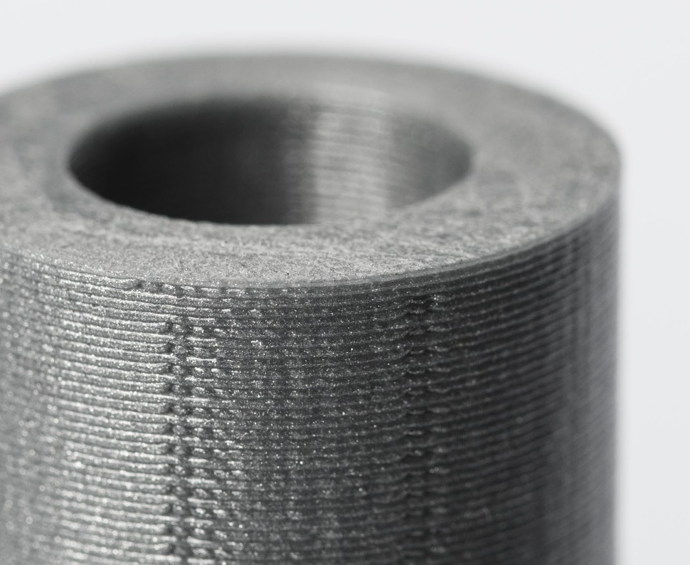
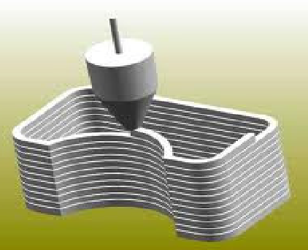
Design considerations for FDM:
More significant layer lines compared to SLS, SLA, DLP
It may be difficult to produce parts with fine features, textures or very thin walls

Slide 33

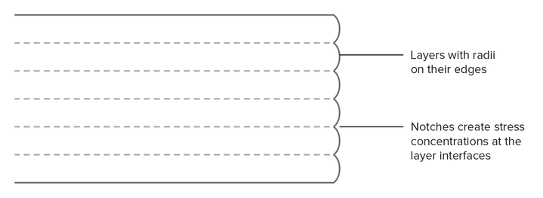
FDM Parts are generally not watertight or airtight
This issue can be mitigated with post processing but will add time and labor to part

Slide 34
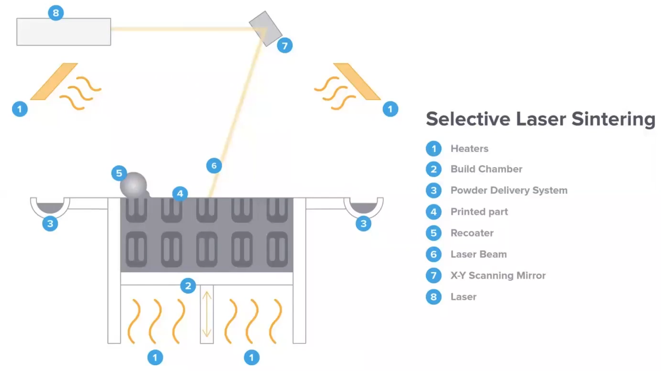
SLS: Selective Laser Sintering
SLS has becoming more popular and does not require support structures

Slide 35
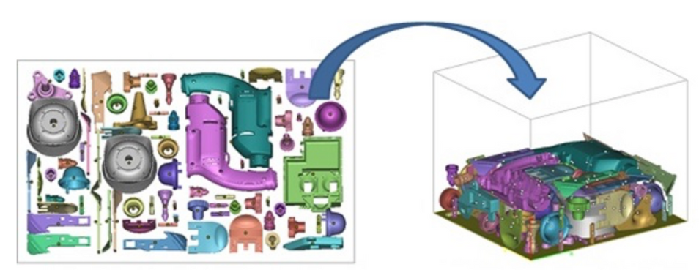
SLS: All part geometry's are functionally self-supporting
Unfused power supports parts during printing. Parts can also be nested on top of each other

Slide 36
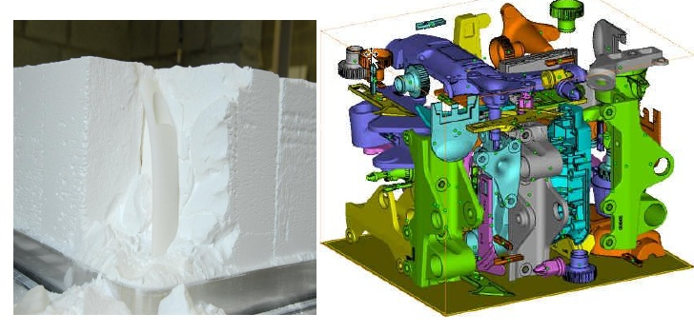
3D Nesting in SLS powder bed fusion “cake”
The unused Nylon power can be recycled for future prints

Slide 37
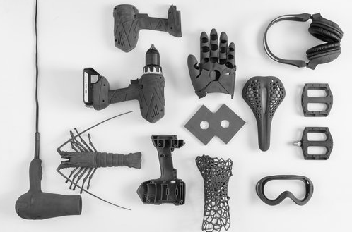
SLS: Nylon is ideal for a range of functional applications, from engineering consumer products to healthcare.
SLS 3D Printing Materials
The most common material for selective laser sintering is nylon, a popular engineering thermoplastic beloved for its lightweight, strong, and flexible properties. Nylon is stable against impact, chemicals, heat, UV light, water, and dirt, making it ideal for both rapid prototyping and production.

Slide 38
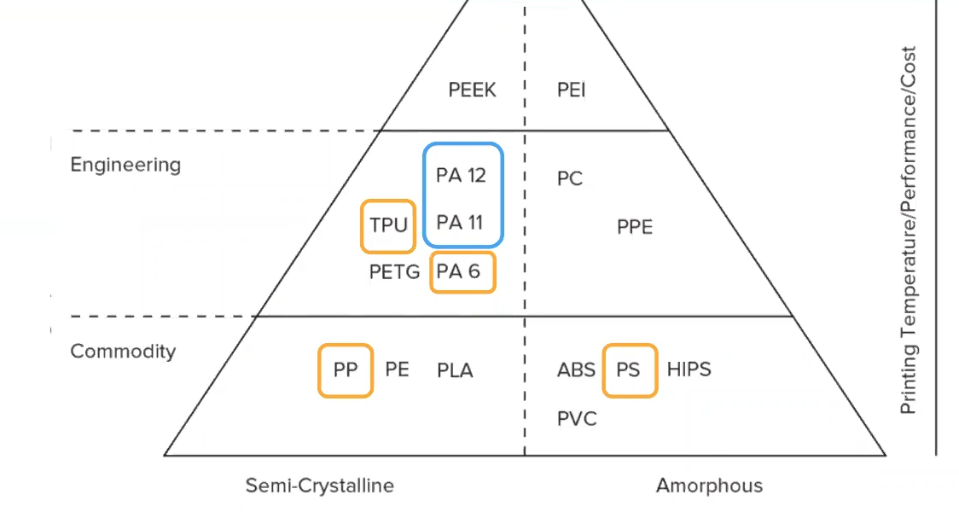
Design considerations of SLS, heat up and cool down time.
Warping may occur if insufficient cool down time
Dusty post processing
Fewer material options than FDM
Very durable parts

Slide 39
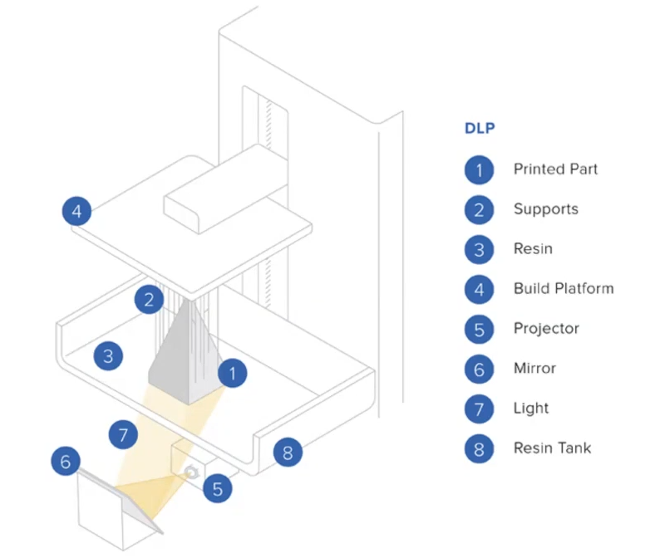
SLA & DLP
Photopolymers
DLP is much faster, uses LED projection
SLA finer resolution uses laser
Watertight
Post cure time

Slide 40
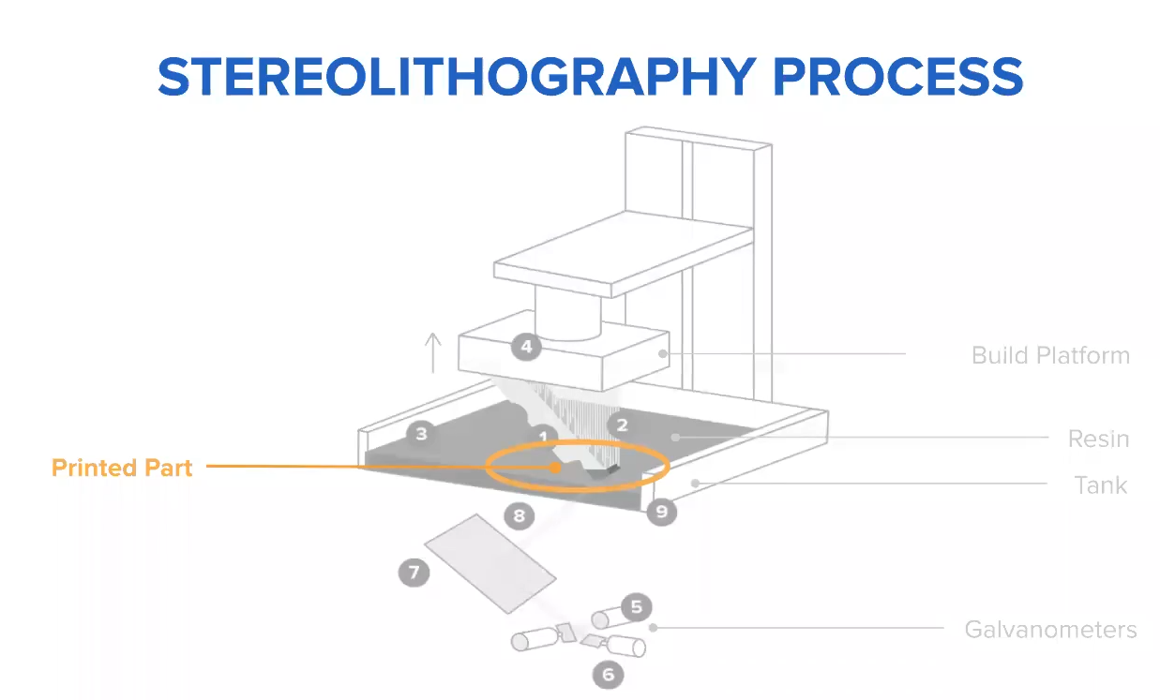
SLA
Very fine resolution 25 micron layers
Liquid Thermoset polymers
watertight parts
Supports are needed to keep build on plate
All layers must have some connections, no island or feathery features without support

Slide 41


SLA – super fine resolution
Can produce highly detailed & translucent parts

Slide 42

SLA parts are highly isotropic, watertight parts

Slide 43

SLA Design considerations; print speed

Slide 44

Print Speed comparison

Slide 45

Post Processing considerations

Slide 46



Support removal – FDM – dissolvable or break away

Slide 47



Support removal – SLA – break away

Slide 48

Support removal – SLS powder

Slide 49

Great skills and technical training for a strong future!
3D Printing; Mass is expensive and complexity is free

Slide 50


This and more at De Anza College in the DMT Dep’t
www.DeAnza.edu/DMT
Build your skills and career opportunities with us now and for the future

Slide 51
www.deanza.edu/dmt/

