Slide 1
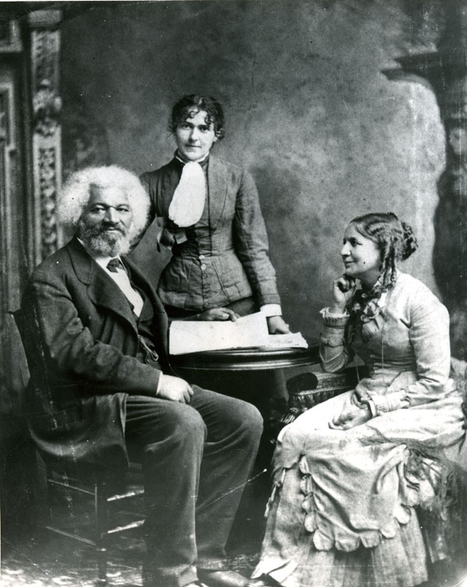
Frederick Douglass
Life and Career
Notes:
Frederick Douglass and his second wife, Helen Pitts Douglass. Helen’s sister Eva is standing.

Slide 2
Douglass’s Early Life
Born in 1818 on Maryland’s eastern shore
His mother was a slave; his father an unknown white man (possibly his master)
At age eight he worked as a house servant in Baltimore, where he learned to read
At age twenty he fled to Massachusetts
By 1841 he was delivering speeches about his life story at antislavery conventions
Notes:
Your students will come to know these facts about Douglass’s early life by reading the Narrative itself. What is worth underscoring at this point are those aspects of Douglass’s biography that may help your students not only to understand Douglass but also to perhaps even identify with him as well. What was it like for Douglass to grow up without a father? What would it have been like to suspect that your father was your master and, more than likely, your mother’s rapist? Douglass moved to Baltimore soon after his mother (and master-father) died. What would it have been like for Douglass’s already tenuous sense of family connection to be uprooted from a rural environment and put into an urban setting where he knew no one? Many of your students are probably around the age that Douglass was when he ran away from slavery (twenty years old). Can they imagine what it would have entailed for Douglass, both physically and mentally, to set out into the unknown, risking his life for the slim possibility of freedom?

Slide 3
Slave Narratives as American Literature
[T]here is one portion of our permanent literature, if literature it may be called, which is wholly indigenous and original . . . I mean the Lives of Fugitive Slaves . . . [A]ll the original romance of Americans is in them, not in the white man’s novel.
—Theodore Parker, from “The American Scholar” (1849)
Notes:
Your students may wonder why they are being asked to read slave narratives in a literature course. Despite having already read a number of different autobiographical narratives in Volumes A and B of NAAL, they may be impatient with having to read anything other than fiction or poetry this far into the nineteenth century. It is worth reminding them that the call to include slave narratives in the canon of American literature extends back to the nineteenth century itself.
Theodore Parker, a Unitarian minister from Boston, wrote a number of essays in which he lamented—as did many other antebellum Americans—the dearth of distinctively American literary productions. In the 1846 essay “The Mercantile Classes,” Parker wrote, “We have no American literature which is permanent. Our scholarly books are only an imitation of a foreign type; they do not reflect our morals, manners, politics, or religion, not even our rivers, mountains, sky. They have not the smell of our ground in their breath. The American literature is found only in newspapers and speeches, perhaps in some novel, hot, passionate, but poor and extemporaneous. That is our national literature.” Three years later, in 1849, Parker identified slave narratives as the ultimate example of American literature: “Yet, there is one portion of our permanent literature, if literature it may be called, which is wholly indigenous and original . . . [W]e have one series of literary productions that could be written by none but Americans, and only here; I mean the Lives of Fugitive Slaves. But as these are not the work of the men of superior culture they hardly help to pay the scholar’s debt. Yet all the original romance of Americans is in them, not in the white man’s novel.”
As you discuss with your students this desire on the part of antebellum critics to think of slave narratives as the most authentic species of American literature, ask them to think about Parker’s phrase “the original romance of Americans” in particular. What is the “romance of Americans”? What values do Americans hold most dear? What values do Americans associate with their national origin? How is it, then, that African American slaves better exemplify these values than do white Americans? What is it about the slave narrative that is able to capture the essence of the American experience better than “the white man’s novel”?

Slide 4
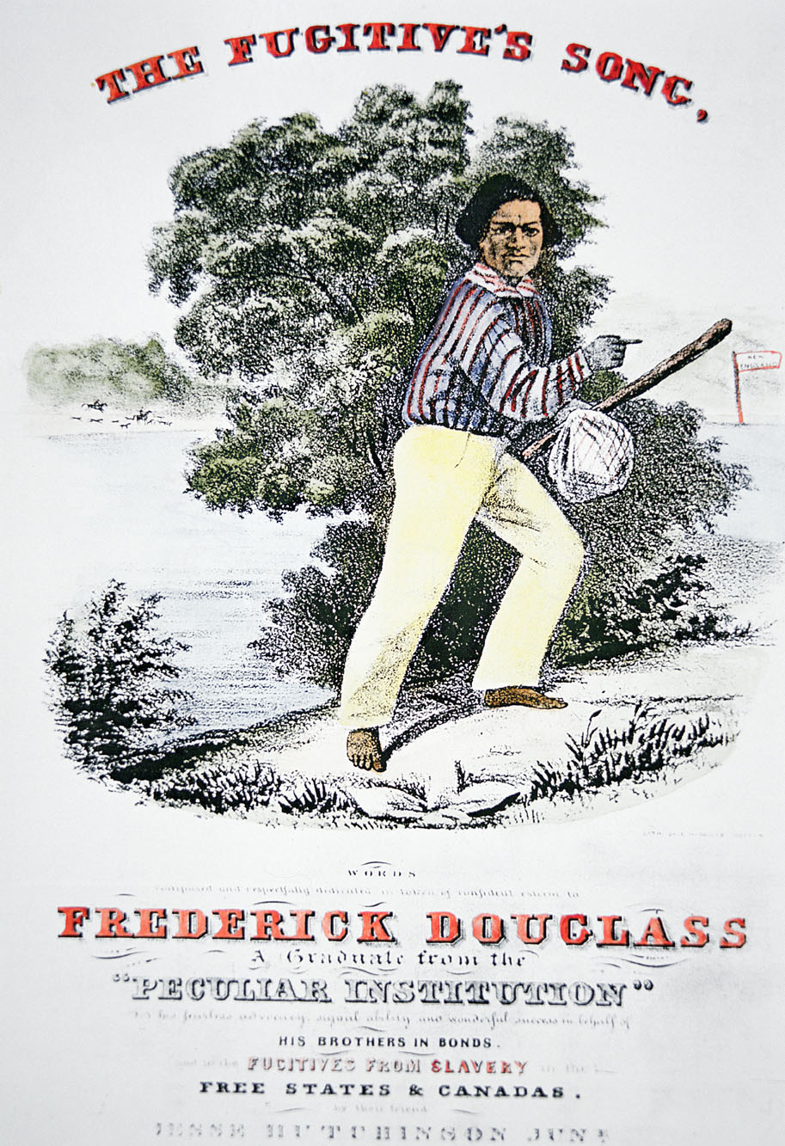
Douglass’s rise to prominence
William Lloyd Garrison took Douglass under his wing soon after he made his way to freedom.
Douglass delivered speeches for Garrison at antislavery conventions and contributed to the Liberator.
Douglass become representative of the African American experience and of abolitionism in particular.
This poster adversises a song composed in honor of Frederick Douglass in 1845

Slide 5
Literacy and the Narrative
Very soon after I went to live with Mr. and Mrs. Auld [in Baltimore], she very kindly commenced to teach me the A, B, C . . . Mr. Auld found out what was going on, and at once forbade Mrs. Auld to instruct me further . . . “Now,” said he, “if you teach [Douglass] how to read, there will be no keeping him. It would forever unfit him to be a slave.” (Narrative, Chapter 6)
Notes:
It is worth spending some time with your students discussing the literary qualities of Douglass’s Narrative. While the narrative is a nonfiction account, the goal of which is provide an accurate retelling of Douglass’s lived experience, Douglass also spent a considerable amount of time shaping and crafting his narrative in a way that would highlight specific aspects of his life that would serve the abolitionist cause. One of the points that Douglass makes over and over again in the Narrative is that learning to read was a key component in his journey toward freedom. For Douglass, literacy was not only proof of his equal claim to humanity but also provided him with access to a larger human community, both in the nation and in the world. Furthermore, Douglass’s ability to acquire literacy despite the active efforts of the white people around him to keep it from him forms a key component of the heroic narrative that he creates: Every bit as much as he is seeking freedom, literacy, too, is the prize, the goal, the boon that Douglass-as-hero acquires in his journey.
As the quotation on this slide demonstrates, the eight-year-old Douglass learned two lessons from his new masters in Baltimore: He learned to read from his mistress and he learned from his master that literacy was a prized possession of white slaveholders that was jealously guarded from black slaves—or, as Douglass himself put it, literacy is “the white man’s power to enslave the black man” (Chapter 6). This moment functions as an early turning point in the Narrative as Douglass becomes fiercely committed to defy his master and learn to read. Douglass writes, “In learning to read, I owe almost as much to the bitter opposition of my master, as to the kindly aid of my mistress. I acknowledge the benefit of both” (Chapter 6).

Slide 6
Literacy and the Narrative
Learning to read with the aid of poor white children in Baltimore
  trading bread for reading lessons
  tricking them into teaching him
Reading The Columbian Orator
  “Dialogue Between a Master and Slave”
  Sheridan’s speeches for Irish independence
Notes:
In addition to being taught by his mistress, Douglass learned to read by enlisting the aid of poor white boys in the streets of Baltimore. Read with your students the passage beginning “The plan which I adopted . . .” in Chapter 7 where Douglass trades bread for reading lessons with “many of the poor white children in our neighborhood.” Compare this passage with the one at the end of the chapter beginning “I soon learned the names of these letters . . .” where Douglass—acting much like Tom Sawyer—tricks some young boys into teaching him how to read and write. There is no doubt that both of these events actually happened to Douglass, but how does Douglass use these episodes for literary effect? What kind of “character” does it present of Douglass to see him alternately use kindness and guile to acquire literacy from the poor white boys of Baltimore?
The other scene of literacy that we get in Chapter 7 is Douglass’s reading of The Columbian Orator (1797), a popular manual designed not only to teach young people how to read and speak eloquently but also to inculcate in them a fierce commitment to the American values of liberty and democracy. By mentioning this text, how does Douglass connect himself to larger American concerns of freedom and education? Douglass specifically mentions an excerpt called “Dialogue Between a Master and Slave” in The Columbian Orator, in which a slave defiantly stands up to his master and uses brilliant rhetoric to convince his master that he has no right to hold him in bondage. Does Douglass imagine that he is himself becoming, through his acquisition of literacy, this defiant and articulate slave? He also mentions Richard Brinsley Sheridan and the eloquent defenses of Irish Catholic independence taking place in Great Britain at the time. It’s obvious why Douglass would find inspiration in “Dialogue Between a Master and Slave,” but why would speeches on the freedom of (white) Irish Catholics interest him? What solidarity does he find in this transatlantic community? Why mention this in a text about the abolition of American slavery?

Slide 7
Physical Struggle
“This battle with Mr. Covey was the turning-point in my career as a slave. It rekindled the few expiring embers of freedom, and revived within me a sense of my own manhood . . . It was a glorious resurrection, from the tomb of slavery, to the heaven of freedom . . . [H]owever long I might remain a slave in form, the day had passed forever when I could be a slave in fact.” (Narrative, Chapter 10)
Notes:
Throughout his Narrative, Douglass presents literacy as something that he actively—even aggressively—claims through his strength and ingenuity. Scholars have noted that there is a particularly masculine character to Douglass’s Narrative, and his acquisition of literacy becomes a part of this masculine struggle. There is also a spectacular moment in the Narrative where Douglass literally calls upon his physical strength to claim his freedom. When Douglass returns to the plantation on which he grew up after having spent almost a decade in Baltimore, he bristles against the restrictions of the overseer, Mr. Covey. Read with your students the section of Chapter 10 that begins “I resolved to fight . . .” Discuss how this episode fits within the larger scope of the narrative and Douglass’s arc as the “main character” of this story: Is this physical battle for freedom more central to the narrative than Douglass’s acquisition of literacy? Is it more central than other major events in his life, such as his actual escape from slavery or his marriage to his wife? Discuss also the literary language that Douglass uses in this passage in the following phrases: “embers of freedom”; “glorious resurrection”; and “slave in form . . . slave in fact.” What is the impact of these particular rhetorical flourishes? Is Douglass merely ornamenting his story with these details, or is this use of literary language essential to understand the story itself?

Slide 8
Friendship and Social Bonds
“It was to those little Baltimore boys that I felt the strongest attachment.” (Chapter 8)
“I was . . . indebted to the society of my fellow-slaves . . . We were linked and interlinked with each other.” (Chapter 10)
“Our confidence in each other was unshaken. We resolved to succeed or fail together.” (Chapter 10)
Notes:
As mentioned in the previous slide, Douglass’s Narrative focuses almost as much on Douglass’s gaining his manhood as it does on his gaining his freedom. One of the major points of contrast between Douglass’s Narrative and Jacobs’s Incidents is that Jacobs focuses more on the social bonds that connect her to her family and friends, whereas Douglass focuses more on his individual quest for freedom (his marriage to his wife, for example, is barely mentioned in the closing pages of the book). Nevertheless, there are a number of key moments in the Narrative where Douglass expresses his gratitude for his friends and the bonds that connect them. After reading the quotations on this slide (and, if necessary, the larger sections from the Narrative where they appear), discuss with your students how Douglass views his individual quest for freedom within the context of his social relationships.

Slide 9
Eloquence
“Our house stood within a few rods of the Chesapeake Bay, whose broad bosom was ever white with sails from every quarter of the habitable globe . . . I would pour out my soul’s complaint, in my rude way, with an apostrophe to the moving multitude of ships:—‘You are loosed from your moorings, and are free; I am fast in my chains, and am a slave!’” (Narrative, Chapter 10)
Notes:
As an orator, Douglass was well known for his eloquence. His Narrative contains a number of moments where this eloquence is on display, such as this apostrophe to the ships on the Chesapeake Bay in Chapter 10. Read through the section beginning with the line “Our house stood within a few rods of the Chesapeake Bay . . .” and ending with “There is a better day coming.” Discuss with your students the images that Douglass uses in this passage to describe his condition as a slave. Talk about Douglass’s use of the apostrophe in particular: Why does he employ a literary device usually associated with lyric poetry in this prose narrative? What does he achieve—stylistically and thematically—with this apostrophe to the ships in the Chesapeake Bay?

